Slide 1


Biomechanical modeling of Tissue perfusion in Decellularized and Native liver
Kenichiro nishii¹, erik brodin¹, greg reese¹, emma moran², Jessica L. Sparks¹
¹Miami University, Oxford, OH
²Wake forest institute for regenerative medicine, Winston Salem, NC
SMB 2017

Slide 2
background

Slide 3
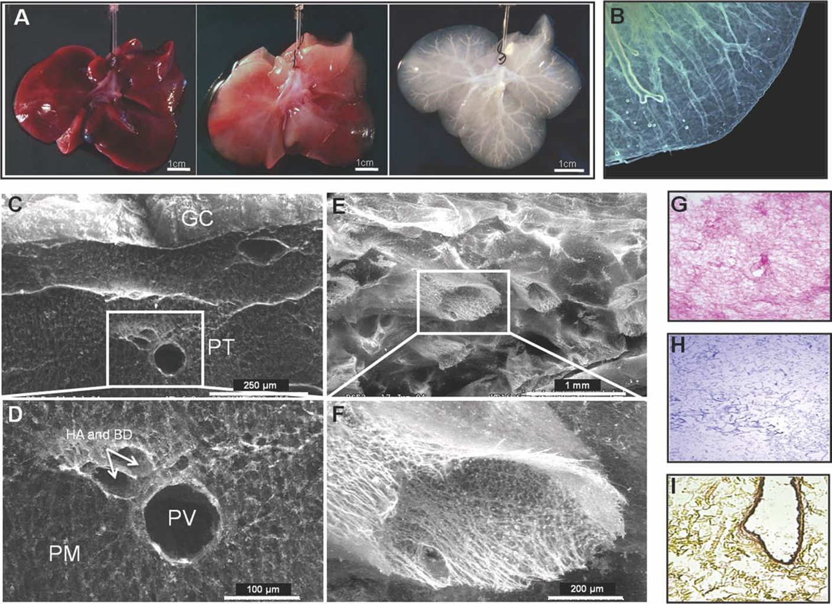
Model system: Decellularized Liver
Baptista PM et al, (2011) Hepatology 53, 604-617.
Notes:
Whole organ decellularization is a technique to eliminate all cellular components to create a scaffold that retains the liver’s original extracellular matrix architecture and vascular network. Image (A, B) shows ferret liver in original state (far left), and progressive loss of cells until empty scaffold is created.
This method is used to generate scaffolds for liver bioengineering. Serves as the model system for the present study.

Slide 4
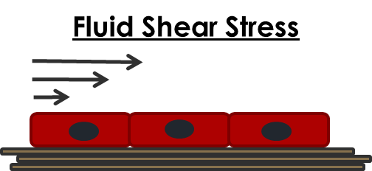
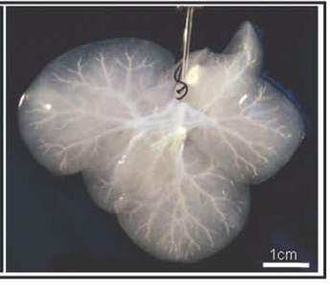
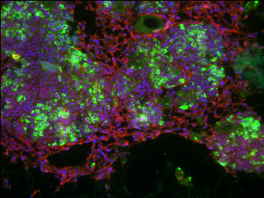
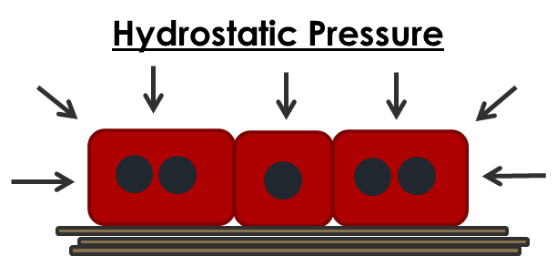
1-10 cm
1-10 mm
100 – 1000 μm
1-100 μm
Mechanical forces have important effects on liver cells
The mechanical environment in perfused decelllularized scaffolds is largely unknown
Guiding hypothesis:
Multiscale computational modeling can be used to assess and to optimize mechanical forces in perfused scaffolds
Goal:
To quantify the mechanical microenvironment in perfused decellularized liver, using a combined experimental/ computational approach
Nishii K et al. Journal of the Mechanical Behavior of Biomedical Materials 57 (2016) 201-214.
Notes:
Describing the mechanical environment in liver is a multiscale problem.
Understanding/controlling these forces is important for generating functional, viable tissue.
(This work was published in 2016, citation below.)

Slide 5
methods

Slide 6
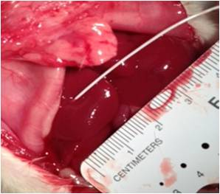
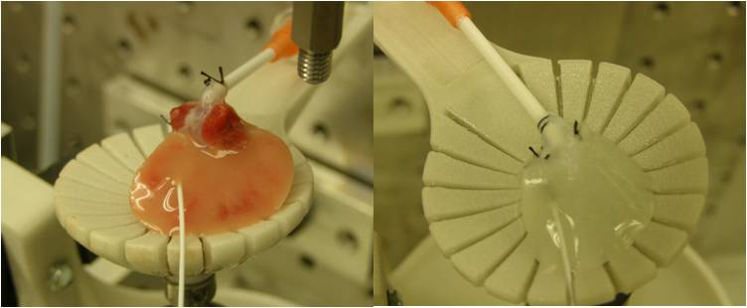
experiments: Parenchymal fluid pressure (PFP)
Ex-Situ Measurements
In-Situ Measurements
Right lobe isolated from native and decell ferret livers
Scaffolds perfused via the portal vein at 3, 6, 9, 12 ml/min
PFP measured with needle-guided transducer tipped catheter
PFP was measured in 5 rats
6 locations per animal
Physiological flow rate
Protocol reviewed and approved by ACUC at WFUHS.
Moran et al. (2012) Biomed Sci Instrum 48, 303-309.
Notes:
PFP is analogous to interstitial fluid pressure.

Slide 7
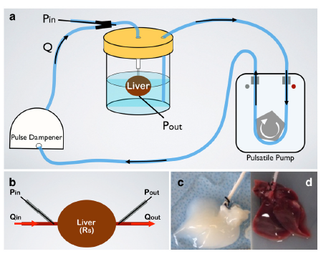
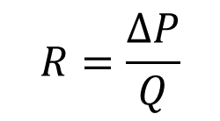
Experiments: pressure drop across entire scaffold
Inlet pressure measured near portal vein cannula for 3,6,9,12 mL/min
Recorded with and without liver attached, to account for resistance due to tubing/hardware
Pressure drop used to approximate net resistance:
$$R=\frac{∆P}{Q}$$
Notes:
The total resistance across the liver, estimated from the pressure drop experiments, was used to validate the optimized resistance parameters of the electrical analog model, which we will discuss next.

Slide 8
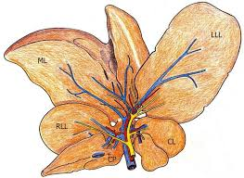
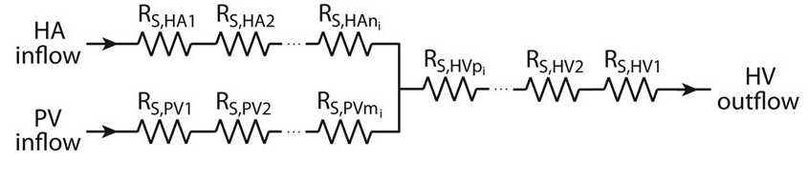
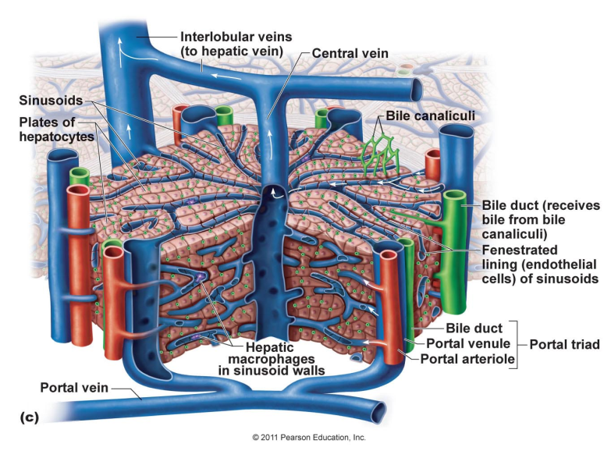
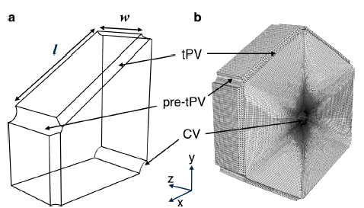
Overview of computational modeling approach
Organ Scale Model of Liver Hemodynamics
Debbaut et al. IEEE Trans Biomed Eng 2012;59(12):3293-3302.
Calculates pressure and flow at EACH GENERATION of the liver vascular tree.
Analogy to electrical circuit:
Voltage ~ Pressure
Current ~ Flow
Tissue Scale Model of Lobule Perfusion
tPV
Calculates PFP, fluid velocity, and ECM stress/strain throughout lobule
pre-tPV
CV

Slide 9
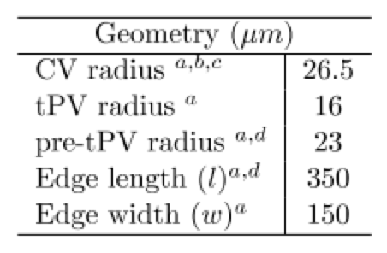
Tissue Scale Model of Lobule perfusion: Finite Element (FE) Model
Two FE models created in Abaqus (Native, Decell)
Common geometry used for both models
178,283 elements in quarter-lobule model
Simulations run via Ohio Supercomputer Center
Notes:
simulation run time = 12 hours

Slide 10
FE Material properties
Modeling liver tissue parenchyma as a biphasic material, consisting of fluid and solid components, much like a sponge.
Deformable Solid Component
Rate-Indepependent Tissue Response: Linear Elasticity
Rate-Dependent Tissue Response: Viscoelasticity
Fluid Component
Darcy’s Law
Governs fluid flow through solid matrix
Movement of fluid through tissue is driven by pressure and depends on permeability

Slide 11
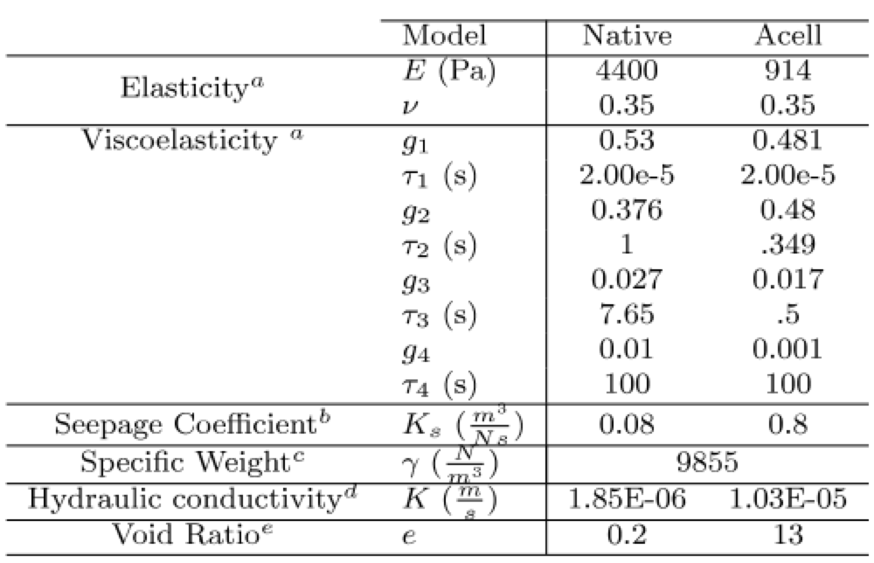
FE Material properties
From previous micro-scale experiments on native and decell liver
(Evans et al. (2013) Biomech Mod Mechanobiol 12(3) 569-580.)
Calculated from density, viscosity, void ratio, and sinusoid geometry
From microscopy image analysis (segmentation of void and solid regions in decellularized liver)
Decellularized liver permeability is 5.6 times greater than native
Notes:
Void Ratio = V_{v}/V_{s}
Hydraulic conductivity, K = permeability (m^4/Ns) * specific weight (kg/m^3 * m/s^2)

Slide 12
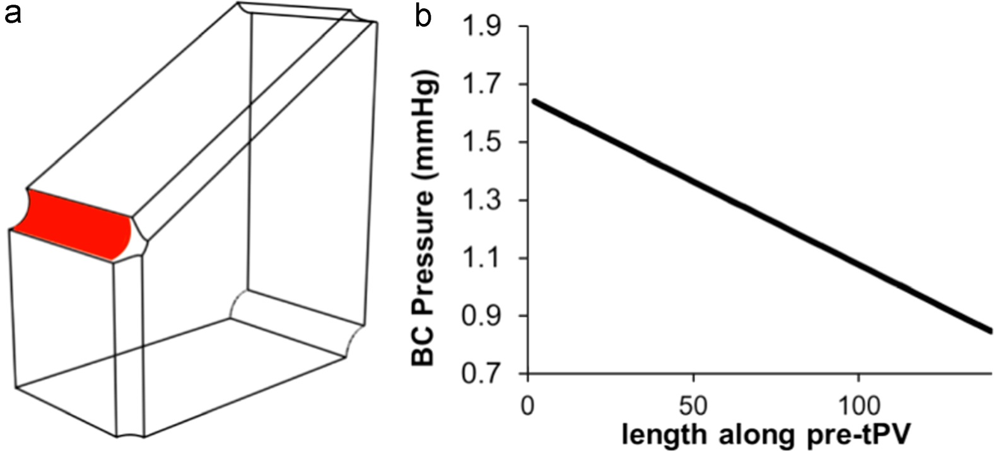
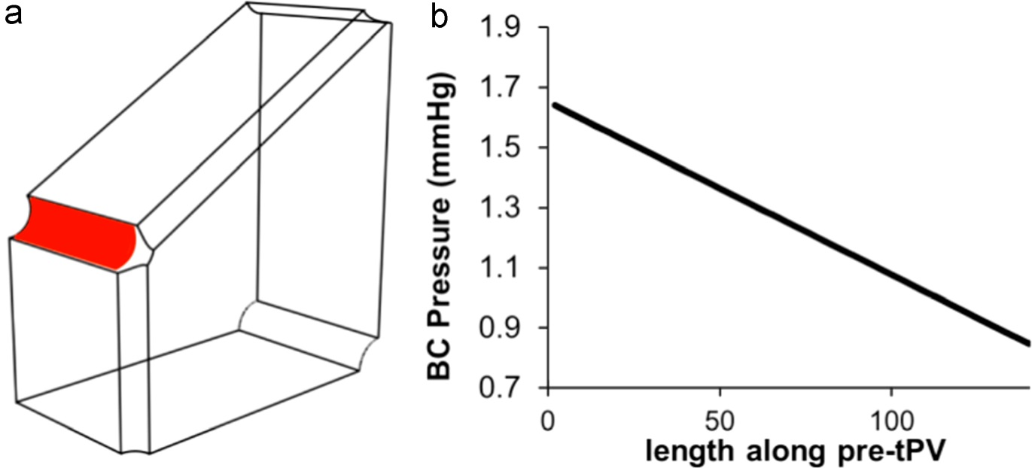
Boundary Conditions
Terminal PV pressure from EA model (magnitude above CV pressure)
Symmetry
(X plane)
Pre-terminal PV pressure
from EA model (varies along vessel length)
CV surface
pressure = 0
(sink)
Symmetry (Y plane)
Notes:
To avoid adjacent nodes between tPV and pre-tPV having multiple boundary conditions assigned, a linear relation was used to model pressure variation along length of pre-tPV in z direction. Consistent with reported patterns of linearly decreasing hydrostatic pressure in microvasculature (Koeppen and Stanton 2010).
Figure shows the linear relation for dcellularized liver FE model 9 mL/min case
BCs in bold vary depending on flow rate and native vs decell state.
Assumed uniform expansion in axial direction, no expansion in longitudinal (z) direction, consistent with prior studies (Bonfiglio et al. 2010).

Slide 13
Results

Slide 14
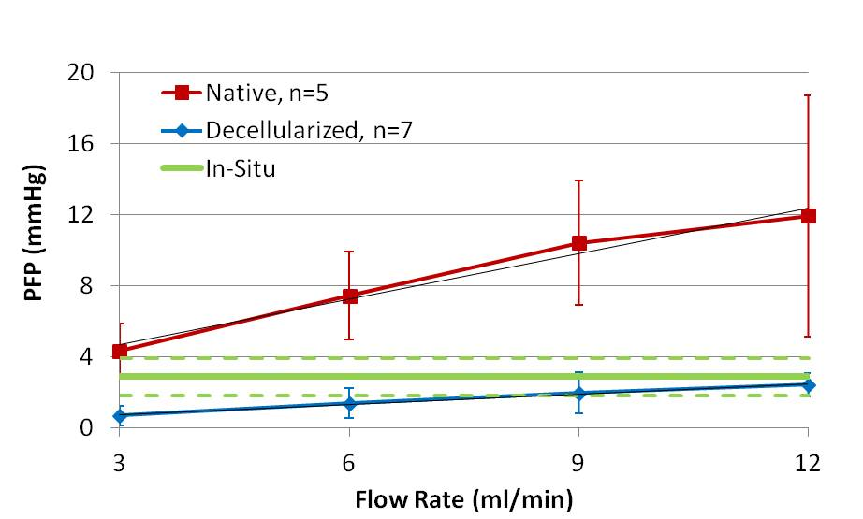
experiments: Parenchymal fluid pressure (PFP)
Ex-Situ Measurements
In-Situ Measurements
PFP: 2.86 ± 1.04 mmHg
In-situ Group | Ex-situ Group | p-value
Right lobe in-situ | Native ex-situ: 3 ml/min | .372
 | Native ex-situ: 6 ml/min | .002*
 | Native ex-situ: 9 ml/min | .000*
 | Native ex-situ: 12 ml/min | .000*
 | Decellularized ex-situ: 3 ml/min | .034*
 | Decellularized ex-situ: 6 ml/min | .122
 | Decellularized ex-situ: 9 ml/min | .292
 | Decellularized ex-situ: 12 ml/min | .527
Linear correlation between PFP and flow rate.
Decellularized liver PFP is lower than its native counterpart.
Notes:
Suggests resistance is decreased by decellularization $R=\frac{∆P}{Q}$

Slide 15
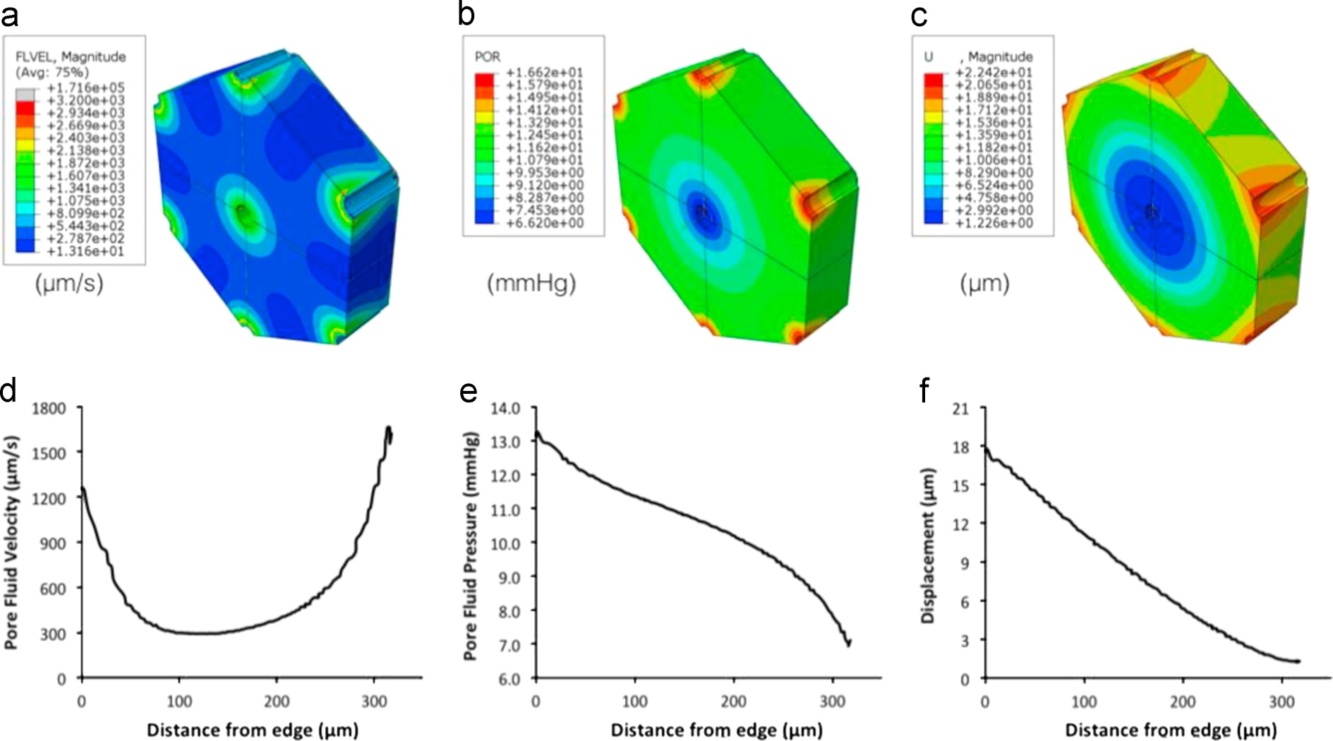
Tissue Scale Model of Lobule perfusion: Results for native liver
avg = 609 μm/s
avg = 10.2 mmHg
avg = 7.2 μm
Fluid velocities highest near vascular inlet/outlet channels.
Pressure shows sigmoidal decrease from inlet to outlet.
Notes:
Results shown for 9 mL/min flow rate

Slide 16
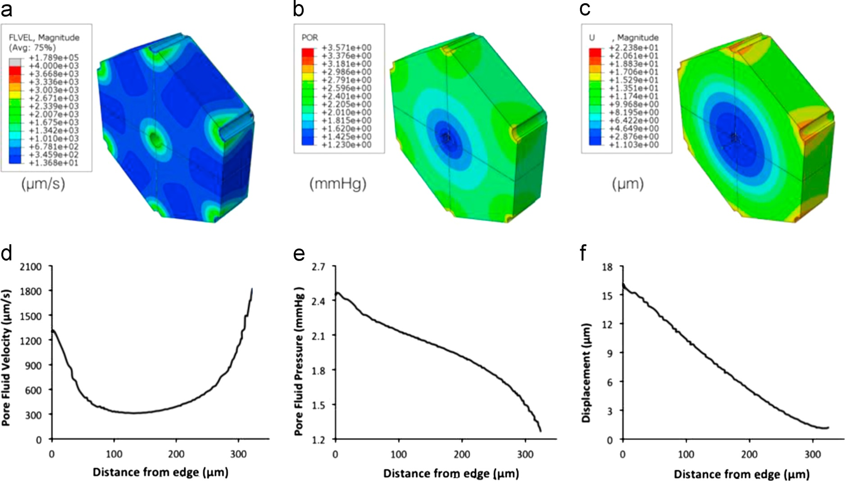
Tissue Scale Model of Lobule perfusion: Results for decellularized liver
avg = 618 μm/s
avg = 1.89 mmHg
avg = 6.3 μm
Same trends, but much lower pressures

Slide 17
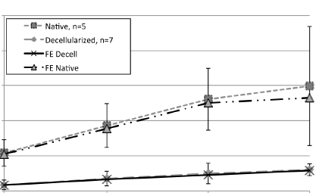
validating the tissue scale FE model output
Experimental Perfusion Rates:
Average FE model pore fluid pressure compared with measured PFP
Physiological Perfusion:
Averge pore fluid velocity (native model) = 278 μm/s
Measured plasma velocity in rat sinusoids = 100-750 μm/s
(Koo and Liang (1979) J Physiol 295, 191-199)
20
Native
16
Hydraulic conductivity
Native model: K= 1.85 x10⁻⁶ m/s
Calculated from fluid properties (ρ,μ), void ratio, and vessel geometry - not optimized!
Literature values: K = .24 x 10⁻⁶ to 9.9 x 10⁻⁶ m/s
12
PFP (mmHg)
8
Decell
4
3
6
9
12
Flow Rate (mL/min)
Notes:
Three validation strategies indicated good agreement between the FE model predictions and literature/experimental results.
experimental measures of parenchymal fluid pressure (PFP)
For (1), FE model pore fluid pressures were calculated along 3 parallel paths running from the pre-terminal portal vein to central vein. Results of the three paths were then averaged, for comparison with experimental measurements. Model results showed good agreement with our experimental PFP measurements.
(2) independent measures of plasma fluid velocity
When physiological flow rate was applied to the native model, the average model-predicted pore fluid velocity is within the reported range of plasma velocity measured in rat sinusoids
(3) Our calculated model hydraulic conductivity (e.g. permeability) for native liver (1.85 x 10⁻⁶ m/s) is in good agreement with the reported range in literature (0.24x10⁻⁶ to 9.9x10⁻⁶ m/s) (Kerdok, 2006; Debbaut et al., 2012)

Slide 18
conclusions / Applications to Cancer

Slide 19
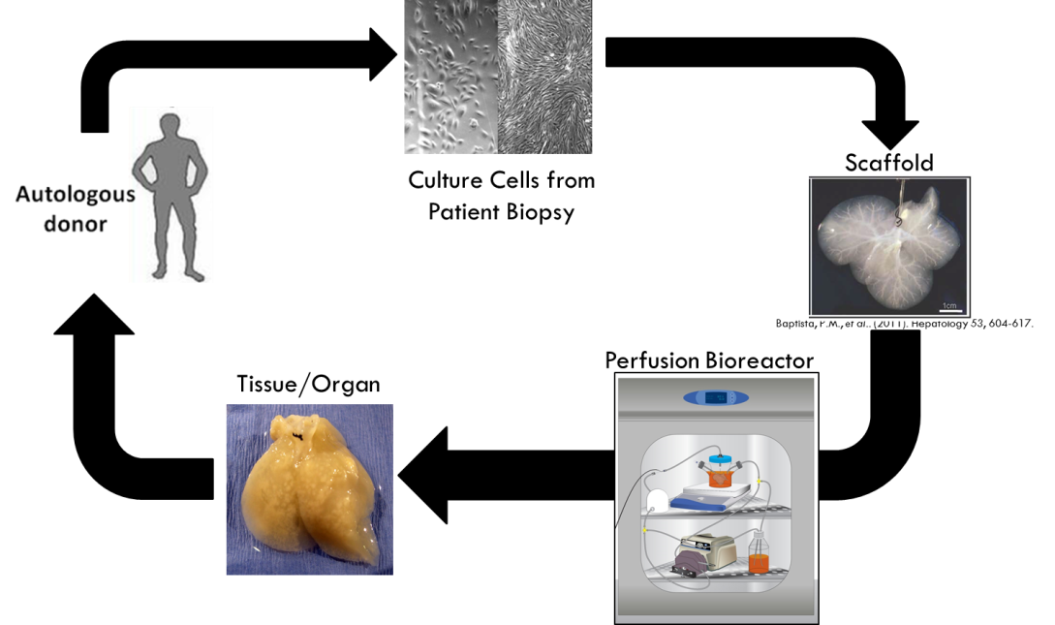
Conclusions
We developed and validated a multiscale computational model of decellularized liver perfusion
We can use the model to
understand the mechanical forces in perfused decellularized scaffolds
test the effects of different mechanical environments on cell seeding, growth, and organization of functional bioengineered liver tissue
optimize perfusion bioreactor conditions
This model system
(scaffold + cells + bioreactor + computational model) is also being used to study the process of colon cancer metastasis to the liver.
Nishii K et al. Journal of the Mechanical Behavior of Biomedical Materials 2016; 57 :201-214.

Slide 20
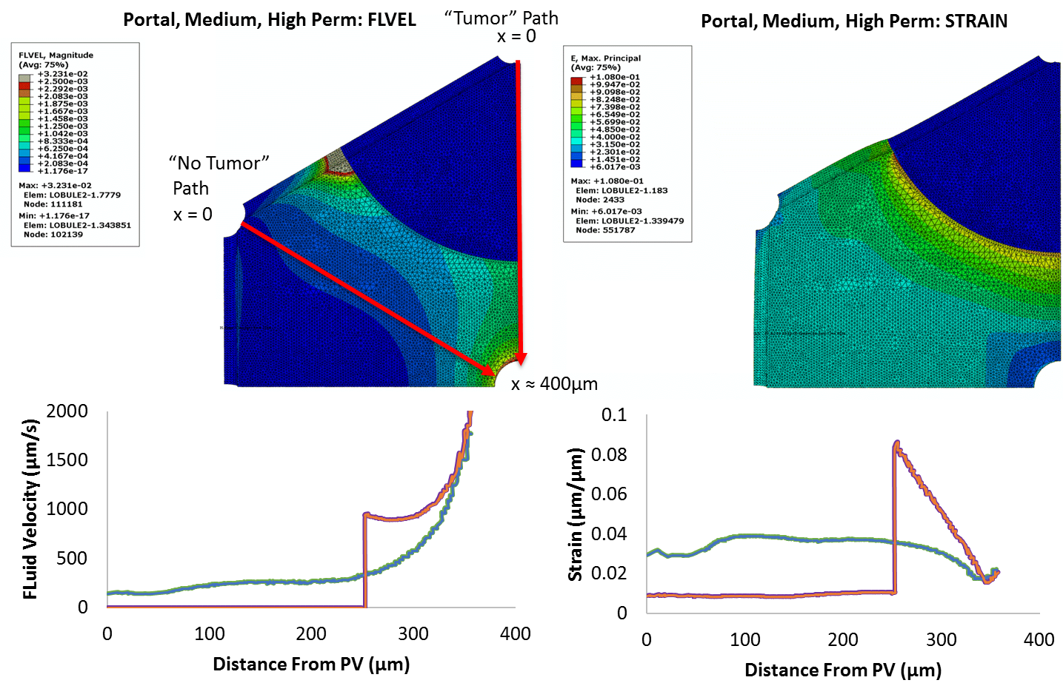
Application to Cancer metastasis: work in progress
“No tumor” path
“No tumor” path
“Tumor” path
“Tumor” path
Flow stagnates within tumor (left); Strains spike at tumor periphery (right)
Notes:
400 micron (“medium”) diameter tumor, considered as net pressure source (release of fluid from necrotic core exceeds uptake of fluid by cells in the viable rim).
Ran models for high and low tumor permeability conditions, results here shown for high permeability.
Line plots shown for path taken from pre-terminal portal vein to central vein. Two paths, one through normal parenchyme (“no tumor” path) and one through tumor (“tumor” path). See red lines with arrows on top left figure.
Left side shows fluid velocity across the lobule. For “no tumor” path, flow velocity increases approximately exponentially from portal vein to central vein. For “tumor” path, flow stagnates within tumor, then fluid velocity increases abruptly just outside tumor margin.
Right side shows strain across the lobule. For “no tumor” path, strains are relatively steady at about 3%, then decrease near central vein. For “tumor” path, strains increased sharply at the tumor boundary to a peak value of 9%, highest value observed in the conditions we tested.

Slide 21
acknowledgments
Kenichiro Nishii
Greg Reese, PhD
Emma Moran, PhD
Shay Soker, PhD
Pedro Baptista, PhD
Doug Evans, MS
Miami Redhawk Cluster
Ohio Supercomputer Center
Funding sponsors:
DHHS 5R01CA180149-02
USC Subaward 45391782
Dept. of Chemical, Paper, and Biomedical Engineering, Miami University

Slide 22
Biomechanical modeling of Tissue perfusion in Decellularized and Native liver
Kenichiro nishii¹, erik brodin¹, greg reese¹, emma moran², Jessica L. Sparks¹
¹Miami University, Oxford, OH
²Wake forest institute for regenerative medicine, Winston Salem, NC
Thank you!

